Slide 1
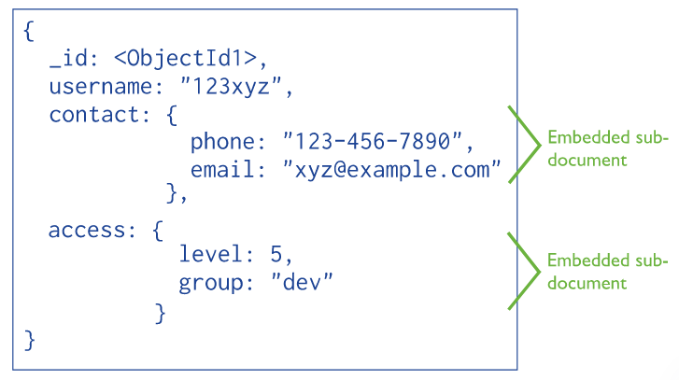
Data Model Design
With MongoDB, you may embed related data in a single structure or document. These schema are generally known as “denormalized” models, and take advantage of MongoDB’s rich documents.
Embedded data models allow applications to store related pieces of information in the same database record. As a result, applications may need to issue fewer queries and updates to complete common operations.
In general, embedding provides better performance for read operations, as well as the ability to request and retrieve related data in a single database operation. Embedded data models make it possible to update related data in a single atomic write operation.
Embedded Data Models

Slide 2
Data Model Design
Embedded Data Model and Document Size Limit
Documents in MongoDB must be smaller than the maximum BSON document size.
The maximum BSON document size is 16 megabytes.
The maximum document size helps ensure that a single document cannot use excessive amount of RAM or, during transmission, excessive amount of bandwidth. To store documents larger than the maximum size, MongoDB provides the GridFS API.

Slide 3
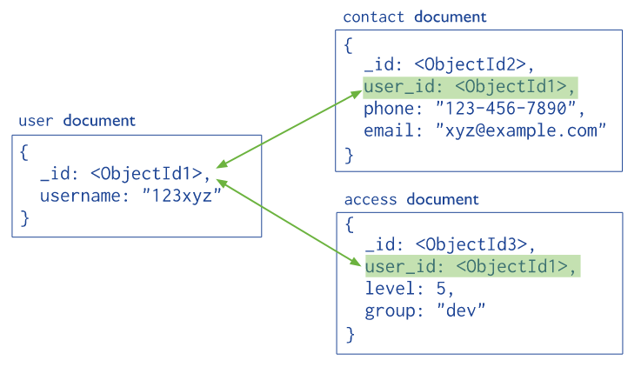
Data Model Design
Normalized data models describe relationships using references between documents.
In general, use normalized data models:
when embedding would result in duplication of data but would not provide sufficient read performance advantages to outweigh the implications of the duplication.
to represent more complex many-to-many relationships.
to model large hierarchical data sets.
Normalized Data Models

